Slide 1


Método
de
Newton-Rapson

Slide 2
Método
de
Newton-Rapson
Francisco Rivero Briseño I. F.

Slide 3
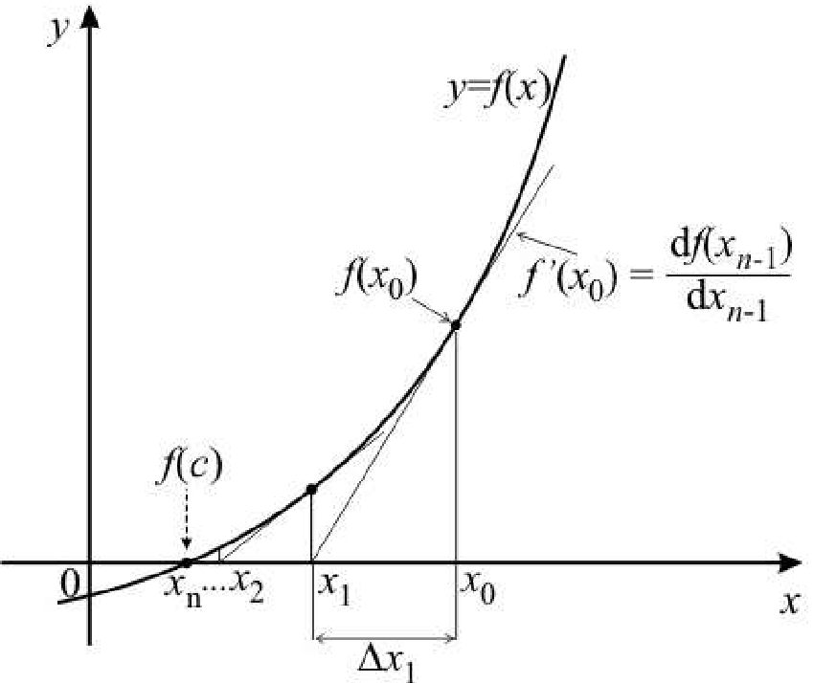
Método
de
Newton-Rapson
Francisco Rivero Briseño I. F.

Slide 4





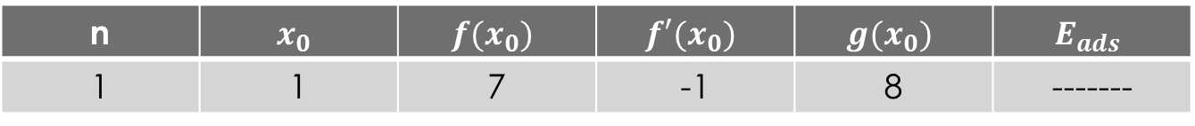


Calcula la solución de la siguiente ecuación, con un margen de error de 0.001
$$f\left(x\right)=x^{3}−2x^{2}+8$$
$$g\left(x\right)=x_{0}−\frac{f\left(x_{0}\right)}{f′\left(x_{0}\right)}$$
$$f′\left(x\right)=3x^{2}−4x$$
Proponemos el número 1 para comenzar
$$g\left(x_{0}\right)=1−\frac{7}{−1}=8$$
$$x_{0}=1$$
$$f\left(1\right)=1^{3}−2{\left(1\right)}^{2}+8=7$$
$f^{′}(1)=3{\left(1\right)}^{2}−4\left(1\right)=−1$
Por lo tanto tenemos
n | $$x_{0}$$ | $$f(x_{0})$$ | $$f′(x_{0})$$ | $$g(x_{0})$$ | $$E_{ads}$$
1 | 1 | 7 | -1 | 8 | -------
Francisco Rivero Briseño I. F.

Slide 5
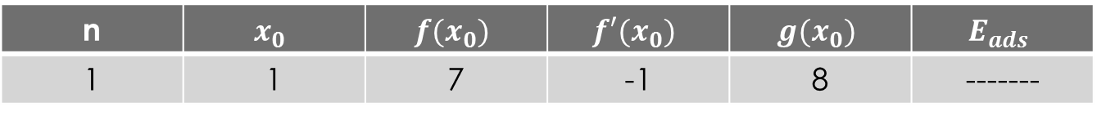


Calcula la solución de la siguiente ecuación, con un margen de error de 0.001
$$f\left(x\right)=x^{3}−2x^{2}+8$$
$$g\left(x\right)=x_{0}−\frac{f\left(x_{0}\right)}{f′\left(x_{0}\right)}$$
$$f′\left(x\right)=3x^{2}−4x$$
n | $$x_{0}$$ | $$f(x_{0})$$ | $$f′(x_{0})$$ | $$g(x_{0})$$ | $$E_{ads}$$
1 | 1 | 7 | -1 | 8 | -------
Este no es menos a 0.001
2
8
392
160
5.55
2.45
3
5.55
Francisco Rivero Briseño I. F.

Slide 6
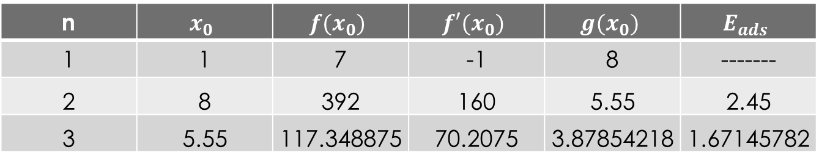
Calcula la solución de la siguiente ecuación, con un margen de error de 0.001
$$f\left(x\right)=x^{3}−2x^{2}+8$$
$$g\left(x\right)=x_{0}−\frac{f\left(x_{0}\right)}{f′\left(x_{0}\right)}$$
$$f′\left(x\right)=3x^{2}−4x$$
n | $$x_{0}$$ | $$f(x_{0})$$ | $$f′(x_{0})$$ | $$g(x_{0})$$ | $$E_{ads}$$
1 | 1 | 7 | -1 | 8 | -------
2 | 8 | 392 | 160 | 5.55 | 2.45
3 | 5.55 | 117.348875 | 70.2075 | 3.87854218 | 1.67145782
Francisco Rivero Briseño I. F.

Slide 7
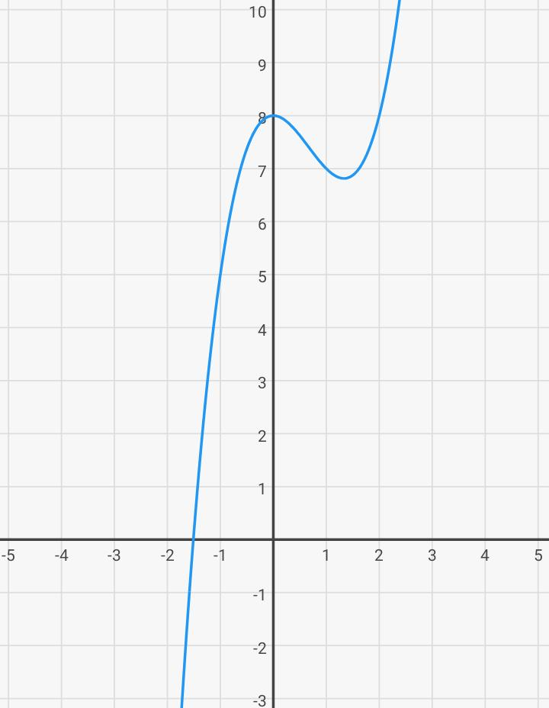

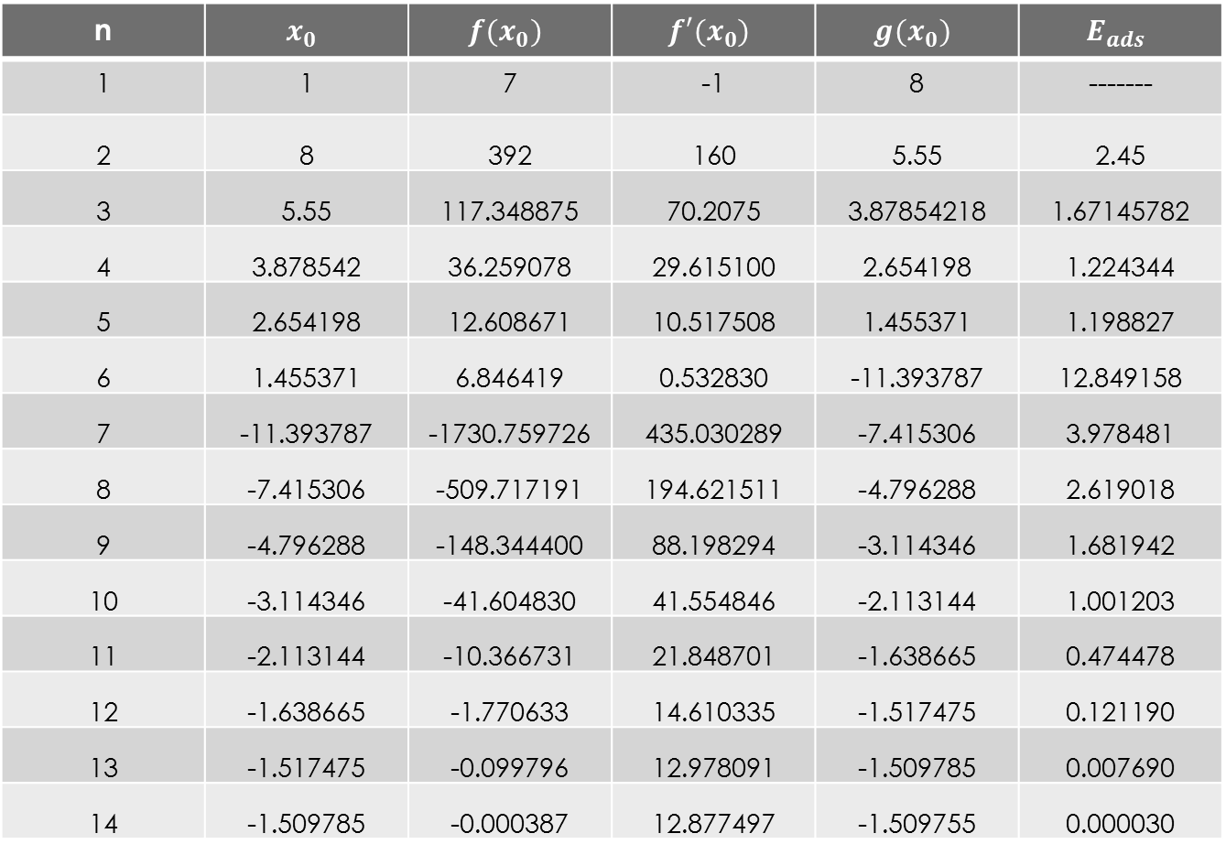
Calcula la solución de la siguiente ecuación, con un margen de error de 0.001
$$f\left(x\right)=x^{3}−2x^{2}+8$$
n | $$x_{0}$$ | $$f(x_{0})$$ | $$f′(x_{0})$$ | $$g(x_{0})$$ | $$E_{ads}$$
1 | 1 | 7 | -1 | 8 | -------
2 | 8 | 392 | 160 | 5.55 | 2.45
3 | 5.55 | 117.348875 | 70.2075 | 3.87854218 | 1.67145782
4 | 3.878542 | 36.259078 | 29.615100 | 2.654198 | 1.224344
5 | 2.654198 | 12.608671 | 10.517508 | 1.455371 | 1.198827
6 | 1.455371 | 6.846419 | 0.532830 | -11.393787 | 12.849158
7 | -11.393787 | -1730.759726 | 435.030289 | -7.415306 | 3.978481
8 | -7.415306 | -509.717191 | 194.621511 | -4.796288 | 2.619018
9 | -4.796288 | -148.344400 | 88.198294 | -3.114346 | 1.681942
10 | -3.114346 | -41.604830 | 41.554846 | -2.113144 | 1.001203
11 | -2.113144 | -10.366731 | 21.848701 | -1.638665 | 0.474478
12 | -1.638665 | -1.770633 | 14.610335 | -1.517475 | 0.121190
13 | -1.517475 | -0.099796 | 12.978091 | -1.509785 | 0.007690
14 | -1.509785 | -0.000387 | 12.877497 | -1.509755 | 0.000030
Solución

Slide 8
Francisco Rivero Briseño I. F.

Slide 9
Gracias
Francisco Rivero Briseño I. F.

